Slide 1
Data Pipeline Demo
Falcon Data Pipeline
Aug 2015

Slide 2
Agenda – Data Pipeline Demo
What is a Data Pipeline
Demo Overview
HDP Components used
Architecture
Demo Process Flow
Input Data
Processing
Output Data
Demo
Resources (How to set it up)

Slide 3
What is a Data Pipeline?
Automated process that executes at regular interval to ingest, cleanse, transform and/or aggregates incoming feed of data to generate the output dataset in the format that is suitable for downstream processing with no manual intervention.

Slide 4
Demo Overview
Lets do Hadoop

Slide 5
Demo Overview
Build a data pipeline to automate the process of ingesting data file with
Input as one or more XML messages (Clinical Data – Subject Visits)
Process includes
Loading the file data to Hive tables
Conversion of XML to JSON
Running aggregate query on table with JSON data
Sqoop the results out of Hive to an external RDBMS (MySQL)
Output is that the processed aggregate data is available in MySQL

Slide 6
Demo - Business Objective
Given the subject visit event data in XML format, generate a report showing the total visits aggregated by study, visit type, year and month.

Slide 7
HDP Components Used
Flume – Spooling Directory Flume agent to bring the data in from landing zone into HDFS
Falcon – Data Governance tool to build the data pipeline (wire the processes together) {Oozie used behind the scenes}
Atlas - Apache Atlas provides governance capabilities for Hadoop.
Hive - for loading and transforming the data
Sqoop - for exporting the data to external RDBMS

Slide 8
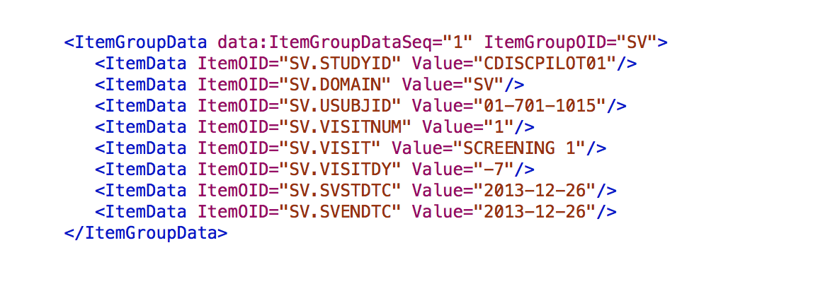
Demo Process Flow - Input
Clinical Research “Subject Visits” data with – Study Id, Visit Type, Visit Date etc.
http://wiki.cdisc.org/display/PUB/CDISC+Dataset-XML+Resources

Slide 9
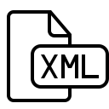




Demo Process Flow - Process
Landing Zone
Hadoop Cluster
Import / Ingest
1
HDFS (Hadoop Distributed File System)
Falcon
Oozie
°
°
°
°
°
°
°
°
°
°
°
°
°
°
°
Cluster
Flume
°
°
°
°
°
°
°
°
°
°
°
°
°
°
°
Feed
Storage
Process
Spool Folder
2
Hive
Output
Export
aggregated
json_data
raw_json
raw_xml
Aggregated data inserted into
Flat JSON inserted into Hive table using Serde
XML converted into flat JSON using UDFs
Flat file loaded from
Input directory
Sqoop
8
5
4
3
RDBMS
7
6
master json
table
xml archive
table
Continuous Process
Scheduled Process

Slide 10
Data Processing Flow (Hive)
raw_xml
insert overwrite table raw_json
select convertJArr2Obj(convertX2J(myrow))
from raw_xml;
raw_json
Single row XML. Raw data loaded directly from file
XML converted into flat JSON using UDFs
1
Import
2
UDFs
3
JSON Serde
insert into table xml_data_archive
select * from raw_xml;
6
Archive Raw
Input Data
LOAD DATA INPATH
'workflow_root_dir}/hivedb/raw_json}/'
OVERWRITE
INTO TABLE sv_json_data};
xml_data_archive
insert overwrite table sv_aggregate}
select studyid,visit,year(svstdtc),month(svstdtc),count(*)
from sv_json_data}
group by studyid,visit,year(svstdtc),month(svstdtc)
sv_aggregate
sv_json_data
Aggregated / rolled up data. Ready to be exported to target DB.
Flattened JSON created using JSON Serde at the time of insert.
7
Export
4
Aggregate
5
Master copy of Aggregated data
insert into table sv_json_data_master
select * from sv_json_data;
sv_json_data_master

Slide 11
Data Processing Flow (Hive)
raw_xml
raw_json
Single row XML. Raw data loaded directly from file
XML converted into flat JSON using UDFs
1
Import
2
UDFs
3
JSON Serde
6
Archive Raw
Input Data
xml_data_archive
sv_aggregate
sv_json_data
Aggregated / rolled up data. Ready to be exported to target DB.
Flattened JSON created using JSON Serde at the time of insert.
7
Export
4
Aggregate
5
Master copy of Aggregated data
sv_json_data_master

Slide 12
Demo Process Flow – Pre-Run Check
Landing Zone
Hadoop Cluster
C
D
Import / Ingest
B
1
HDFS (Hadoop Distributed File System)
Falcon
Oozie
A
°
°
°
°
°
°
°
°
°
°
°
°
°
°
°
°
°
°
°
°
°
°
°
°
°
°
°
°
°
°
Cluster
Flume
Feed
Storage
Process
Spool Folder
2
Hive
Output
E
Export
aggregated
json_data
raw_json
raw_xml
G
F
Aggregated data inserted into
Flat JSON inserted into Hive table using Serde
XML converted into flat JSON using UDFs
Flat file loaded from
Input directory
Sqoop
8
5
4
3
RDBMS
7
6
master json
table
xml archive
table
Continuous Process
Scheduled Process

Slide 13
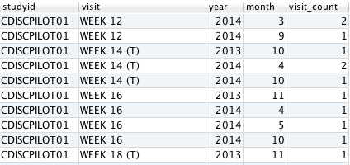
Demo Process Flow - Output
Process execution should produce the following output
Data in JSON Format in the table used for analytical queries in Hive
Raw XML Data in the archive table, to maintain the source data
Aggregated data in the external RDBMS system. – Number of visits made for each study broken down by visit type, year and month.

Slide 14
Demo
Lets do Hadoop

Slide 15
Questions?
We do Hadoop

